Slide 1
Feature Selection using BSO and Q-BSO
Submitted by
Arya Haldar
Manav Goyal
Praveen Kumawat

Slide 2
CONTENTS
OBJECTIVE
01
02
THEORY
IMPLEMENTATION
03
04
CONCLUSION

Slide 3
BEE SWARM OPTIMIZATION
REINFORCED BSO
OBJECTIVES
01
02
Inspired from the interesting foraging behavior of real bees which is the collective intelligence that allows self-organization and dynamic tasks assignment.
Integrate Q-learning to BSO in order to allow bees learning during the search process from their own experience.

Slide 4
Bee Swarm Optimization
Notes:
The inspiration for the BSO algorithm as you guessed correct are bees. A bee may have one of the following types: (employed / unemployed) forager, scout, onlooker, recruit, and experienced forager.A colony of honey bees can extend itself over long distances (over 14 km)^{[6]} and in multiple directions simultaneously to harvest nectar or pollen from multiple food sources (flower patches). A small fraction of the colony constantly searches the environment looking for new flower patches. These scout bees move randomly in the area surrounding the hive, evaluating the profitability (net energy yield) of the food sources encountered.^{[6]} When they return to the hive, the scouts deposit the food harvested. Those individuals that found a highly profitable food source go to an area in the hive called the “dance floor”, and perform a ritual known as the waggle dance.^{[7]} Through the waggle dance a scout bee communicates the location of its discovery to idle onlookers, which join in the exploitation of the flower patch. Since the length of the dance is proportional to the scout’s rating of the food source, more foragers get recruited to harvest the best rated flower patches. After dancing, the scout returns to the food source it discovered to collect more food. As long as they are evaluated as profitable, rich food sources will be advertised by the scouts when they return to the hive. Recruited foragers may waggle dance as well, increasing the recruitment for highly rewarding flower patches. Thanks to this autocatalytic process, the bee colony is able to quickly switch the focus of the foraging effort on the most profitable flower patches.^{[6]}

Slide 5
Bee Swarm Optimization
Bee search process
Selection of the reference solution
Determination of the search region
Notes:
BSO an iterative search process based on a population of artificial bees cooperating for solving an instance of an optimization problem by imitating the foraging behaviour described above. It is based on 3 key steps: – Determination of the search region; – Bee search process; – Selection of the reference solution

Slide 6
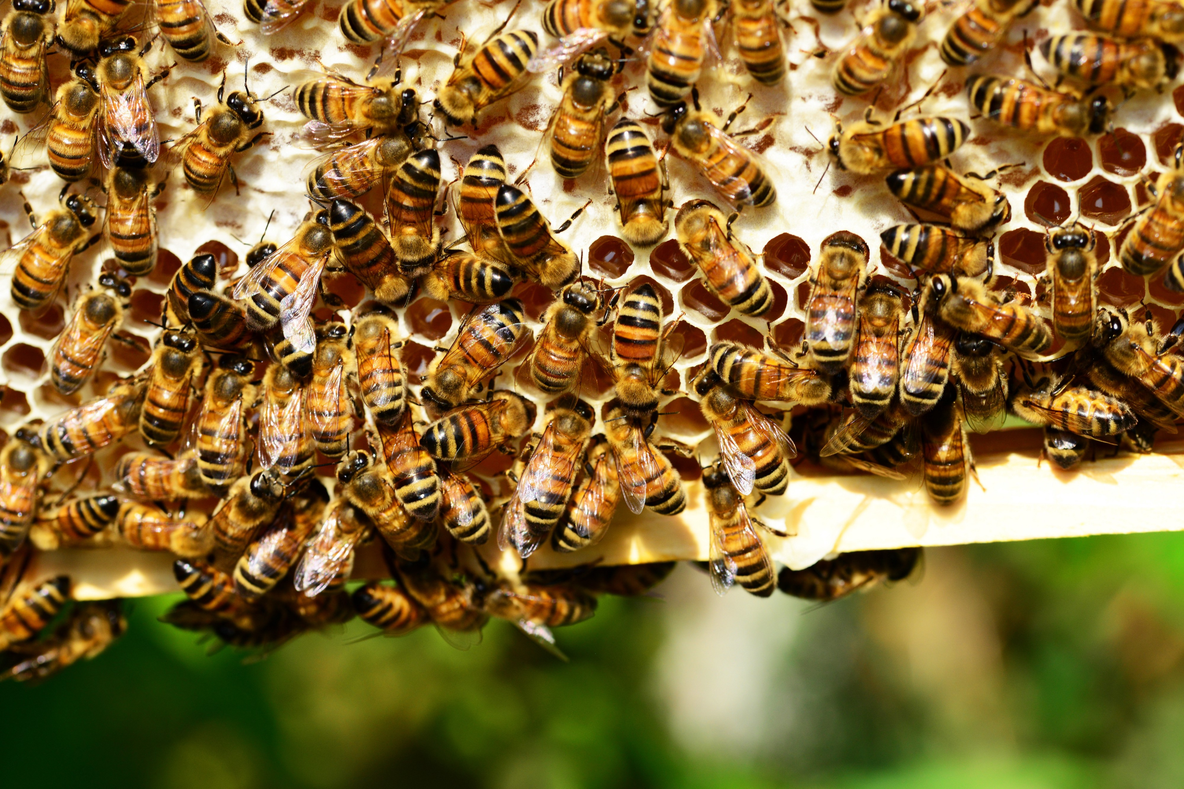
BSO
At the first iteration, an initial solution is generated randomly or via a heuristic. It is considered as the first reference solution RefSol and used to determine a set of N solutions called Search Region.
Each of these solutions are assigned to a bee as a starting point for a local search.
The best found solution by each bee is passed via a table named Dance from which a new RefSol is selected.
In order to avoid cycles, reference solutions are stored in a Tabu list.
Two parameters play an important role in BSO. The first one named flip is used to determine the set of solutions that defines the search region.
These solutions are equidistant from RefSol by a distance inversely proportional to flip. Hence, the value of this parameter must be chosen carefully in order to ensure a good coverage of the search space.

Slide 7
BSO
The second important parameter called MaxChances indicates the number of chances granted to a search region before escaping to another one. Its role is to avoid getting stuck in local optima.
MaxChances value is considered while selecting the reference solution and allows to guarantee a good balance between exploitation and exploration by applying judiciously intensification and diversification principles. Every time the current solution is improved, intensification is performed.
After maxchances iterations, if no improvement is noticed, a diversification is launched.
It consists in selecting from Dance table the most distant solution from all previous reference solutions stored in the Tabu list. The algorithm stops when the optimal solution is found or the maximum number of iterations is reached

Slide 8
MODIFICATION TO BSO
Solution encoding
Search region
01
02
03
Fitness
Notes:
BSO was applied to feature selection by adapting the general algorithm to the specificities of the problem.
Solution encoding: A solution is represented by a binary vector of length n, where n is the original number of features. A position of the vector is set to 1 if the corresponding feature is selected and to 0 otherwise.
– Fitness: It represents the quality of the solution and is noted f(s).
– Search region: It is a set of solutions generated from the reference solution by flipping in refSol a number of bits equal to n/flip, flip being an empirical parameter.The value of flip has an impact on the performance of the research process because it determines the distance between refSol and the solutions which define the search region. Indeed, a too small value will favor the exploration instead of exploitation of the search space, while a too high value might lead the algorithm to converge to a local optimum.

Slide 9
Q Learning
Q-learning falls in the class of reinforcement learning algorithms which deals with learning by interacting with the environment. it is defined by “a way of programming agents by reward and punishment without needing to specify how the task is to be achieved”.
Indeed, the learner (intelligent agent) performs an action based on its state and receives from the environment a reward or a punishment. To maximize the expected sum of rewards, the agent prefers actions performed in the past.
In context to real world, reward can be interpreted as the ‘food’ to each bee which is one of the deciding factors how bees choose optimum solution.
Q-learning consists to learn the value of Q which is the reward received immediately upon executing action at from state s_{t}, plus the value (discounted by γ) computed recursively based on this equation:
Q(s, a) = r(s, a) + γ max Q(δ(s, a), a)
The one-step Q-learning which is used in this project, is defined by
Q(s, a) = (1 − α)Q(s, a) + α(r(s, a) + γ max Q(δ(s, a), a))

Slide 10
QBSO: Q-learning + BSO
We integrate Q-learning to BSO in order to allow bees learning during the search process from their own experience.
Indeed, in BSO, after a bee is assigned a solution, it performs a classical local search where it evaluates all the solutions in its neighborhood and returns the best one. Thus, the bee never uses its experience during this process.
We replace the local search performed by bees by a Q-learning algorithm where each bee is considered as an intelligent agent which gathers experience during its search process and benefits from the experiences of other bees.
The states constituting the environment are all the possible solutions feature subsets in the neighborhood of the bee.
Notes:
An action in our context consists in adding or removing a feature from the current subset which consists in flipping a bit in the current solution. The reward rt associated to a couple (st, at) is computed by taking into account classification accuracy as the main criterion and the size of the features subset as a second criterion

Slide 11
Implementation
We conducted test on both BSO and Q-BSO on following dataset. The accuracy obtain is given below.
Data | BSO | Q- BSO
Iris | 97.33% | 97.33%
Wine | 95.56% | 95.56%
Sonar | 98.22% | 99.04%

Slide 12
Conclusion
QBSO-FS, uses a hybrid BSO with reinforcement learning to perform the search process in its subset generation step.
The results showed that for all datasets, reduced number of features allow to achieve better classification accuracy than the initial set of features.
BSO and QBSO-FS showed that they give generally equivalent accuracy except for some datasets for which QBSO-FS gives better results.
In terms of execution time, the QBSO-FS outperforms BSO-FS for large datasets while they are equivalent for small ones.

Slide 13
THANK YOU

